Slide 1


JOB MARKET ANALYSIS
Forecast Report
Presented by: Hruthik SH

Slide 2


Team ID: PTID-CDA-DEC-25-1098
Project ID: PRDA-04
Internship Program: Capstone Internship Project
Tools Used: Microsoft Excel, Power BI

Slide 3
Task 1 Overview
Task 1 : Get data from the database with the given credentials
In this task, job market data was collected from the database using the credentials provided by the organization. A secure connection was established to access the database successfully. Relevant job-related records were retrieved, including job titles, salary information, company details, and locations. The extracted data was verified for accuracy and completeness. Once validated, the dataset was prepared for further cleaning and analysis. This step ensured a reliable foundation for all subsequent insights and visualizations in Power BI.

Slide 4
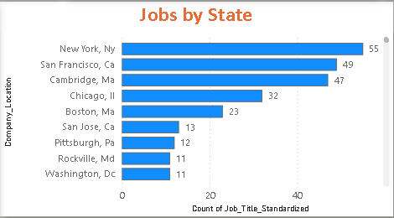
Task 2 Overview
Task 2 : States with Most Number of Jobs
This task focuses on identifying the states with the highest number of job opportunities in the dataset. Job postings were grouped based on state-wise locations to calculate the total number of jobs available in each state. The data was aggregated to highlight regions with maximum hiring activity. This analysis helps in understanding geographic demand for job roles. States with higher job counts indicate stronger employment opportunities. The results provide valuable insights for job seekers and recruiters. Visual representations were created in Power BI to clearly compare job distribution across states.

Slide 5
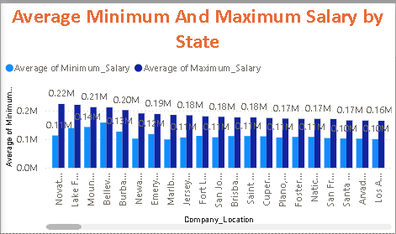
Task 3 Overview
Task 3 : Average Minimal and Maximal Salaries in Different States
This task analyzes the variation in minimum and maximum salary ranges across different states. Job postings were grouped by state to calculate the average lower and upper salary values. This comparison helps in understanding salary distribution and pay ranges by location. States offering higher salary bands were identified through this analysis. The results highlight regional differences in compensation levels. This insight is useful for evaluating cost-of-living and job market competitiveness. The findings were visualized in Power BI for clear and effective comparison.

Slide 6
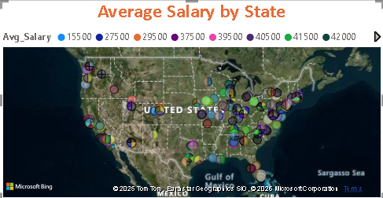
Task 4 Overview
Task 4 : Average Salary in Different States
This task focuses on analyzing the average salary offered across different states. Salary data was aggregated state-wise using the average salary values derived from job postings. The analysis helps identify states that offer higher or lower average compensation. It provides a clear understanding of regional salary trends in the job market. States with competitive salary levels were highlighted through this process. This insight is valuable for job seekers planning relocation and for employers benchmarking pay standards. The results were visualized in Power BI for better comparison and interpretation

Slide 7
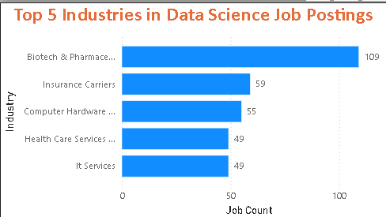
Task 5 Overview
Top 5 Industries with Maximum Number of Data Science Related Job Postings
This task aims to identify the top five industries with the highest number of data science–related job postings. Job data was grouped by industry to calculate the total number of openings in each sector. The analysis highlights industries with the strongest demand for data science professionals. It helps in understanding where data-driven roles are most concentrated. Industries with higher job counts indicate greater adoption of analytics and data technologies. These insights are useful for career planning and industry targeting. The findings were presented using clear visualizations in Power BI.

Slide 8
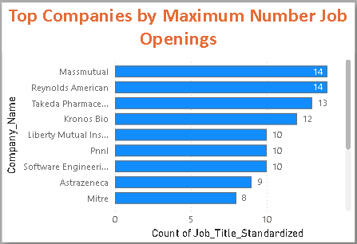
Task 6 Overview
Task 6 : Companies with Maximum Number of Job Openings.
This task focuses on identifying companies that are actively hiring the most in the dataset. Job postings were grouped by company to calculate the total number of openings for each organization. The analysis highlights employers with the highest recruitment activity and indicates competitive hiring trends. Companies with more openings represent significant opportunities for job seekers. These insights help candidates target their applications strategically and allow recruiters to benchmark hiring patterns. The results were visualized in Power BI for clear comparison and interpretation.

Slide 9
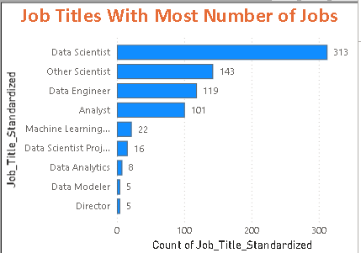
Task 7 Overview
Task 7 : Job Titles with Most Number of Jobs
This task analyzes the demand for different job titles in the dataset. Job postings were grouped by job title to calculate the total number of openings for each role. The analysis helps identify the most in-demand job positions in the current job market. Roles with higher job counts indicate strong industry demand and growth potential. This insight is useful for job seekers to focus on relevant roles and skill development. It also helps organizations understand hiring trends across different positions. The results were visualized in Power BI for easy comparison and clarity

Slide 10
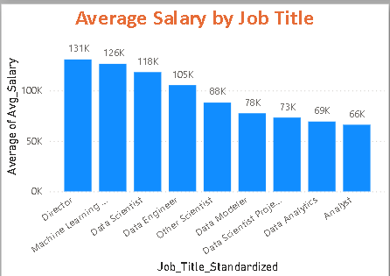
Task 8 Overview
Task 8 : Salary of Job Titles with Most Number of Jobs.
This task examines the salary patterns for job titles that have the highest number of openings. Average salary values were calculated for the most in-demand job roles. The analysis helps compare compensation levels across popular job titles. It provides insights into how salary varies by role and demand in the job market. Roles with higher demand and competitive salaries were identified. This information is useful for job seekers in salary negotiation and role selection. The findings were visualized in Power BI for clear and effective comparison.

Slide 11
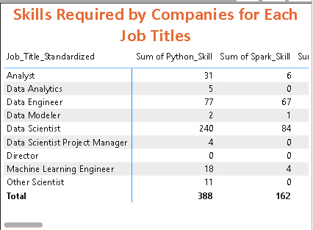
Task 9 Overview
Task 9 : Skills Required by Companies for Each Job Title
This task focuses on identifying the key skills required by companies for different job titles. Job postings were analyzed to map skill requirements against each role. The analysis highlights the most in-demand technical and analytical skills for specific job titles. It helps in understanding how skill expectations vary across roles. This insight supports job seekers in aligning their skill sets with market demand. It also assists organizations in defining role-specific skill requirements. The results were visualized in Power BI for clear interpretation.

Slide 12
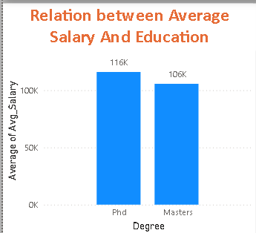
Task 10 Overview
Task 10 : Relation between Average Salary and Education.
This task analyzes the relationship between education level and average salary offered in the job market. Salary data was compared across different education qualifications mentioned in job postings. The analysis helps identify how educational requirements influence compensation levels. Higher education levels were evaluated for their impact on salary growth. This insight is useful for understanding the value of advanced degrees in career progression. It supports informed decision-making for both job seekers and employers. The results were visualized in Power BI for clear comparison and analysis

Slide 13

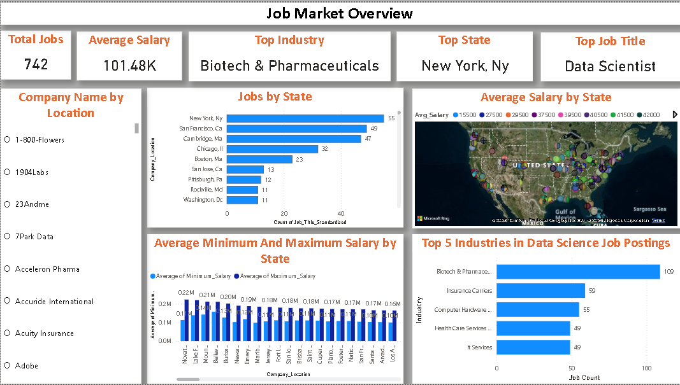
Final Dashboard Overview

Slide 14
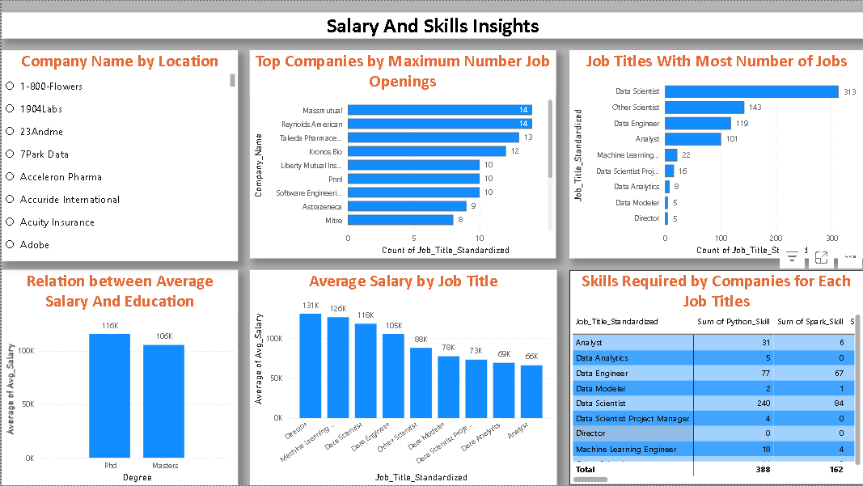
Final Dashboard Overview
Final

Slide 15

Thank You

